Slide 1
Java Basics
Session 2

Slide 2
Contents
Brief history of Java
Language fundamentals
Data types
Variables
Operators
Conditional Operators
Loops
Functions
Arrays
Enhanced for loop

Slide 3
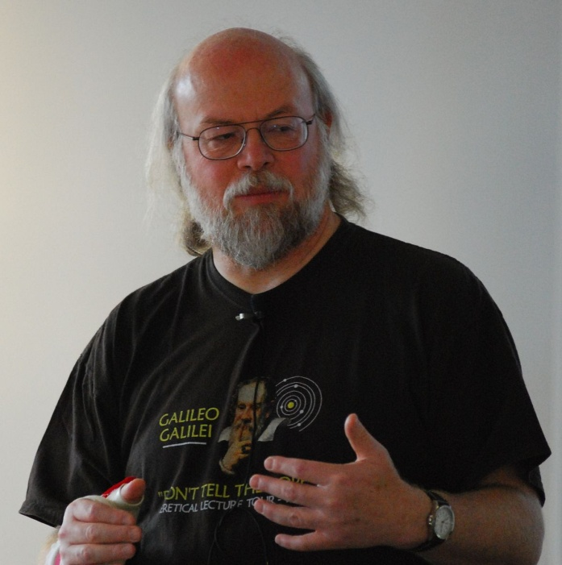
Brief History of Java
Invented by James Gosling at Sun Microsystems.
Origin name was OOK later renamed as Java.

Slide 4
Features of Java
General Purpose
Class based
Object oriented
Platform Independent
Distributed
Portable (Flavors of Java)
JSE
JME
JEE/J2E
Robust
Interpreted

Slide 5
Keywords
Keywords are certain reserved words which meaning is known to compiler.
Compiler is capable to work on them.
if, else, for, class, break, while, switch, case etc.

Slide 6
Variable
Variable is name of memory location where certain value is stored.
Variable is a container. Which stores some value
Name of variable
no1
100
Value
1000
Address

Slide 7
Rules for variable name
Contain combination of A-Z, a-z, 0-9 & _
Should not start with number.
Should not contain any special character and white space.

Slide 8
Data types
Data type is nothing but type of data stored in variable.
Integer – whole number
Decimal numbers – 3.412 – float
12345679.4563217 – double
Character – single character
String – collection of characters.

Slide 9
Types of Data Type
Primitive
int, char, float, double, boolean
Non Primitive
String

Slide 10
Operators
Operators are mathematical symbols which are used to perform some operations.
Operators
Unary
++, --, -, !
Binary
Ternary
Arithmetic
+, -, *, /, %
Conditional
<, >, <=, >=, ==, !=
Assignment
=, +=
:?
Logical
&&, ||

Slide 11
Operator, Operand & Expression
Operands
Statement / Expression
sum = no1 + 50;
Operator

Slide 12
Writing 1st Java Program
Folder
Select Workspace
Create Project
Package
Class (Program)

Slide 13
Basics of Java
Displaying something on console
System.out.println()
This is the function which is used to display some message on screen.
Eg. System.out.println(“Hello Friends!!!”);
Workspace (Folder) → Project → Package → Class

Slide 14
Checking conditions
For checking any condition in Java, one can use several statements like
if
if – else
nested if
switch-case

Slide 15
if condition
if condition is one of the conditional statement in Java.
It is used to check a condition and executing or skipping some statements depending on condition.
Syntax
if(condition / expression)
{
Statement(s);
}

Slide 16
Condition
False
Statement/s
True
Statement/s
Exit

Slide 17
if – else statement
It is extension of simple if statement.
Syntax
if(Condition / Expression)
{
Statement(s);
}
else
{
statement(s);
}

Slide 18
Nested if – else
Used when more then one condition is needs to be checked.
Syntax
if(condition)
{
statement(s);
}
else
{
if(condition)
{
statement(s);
}
else
{
statement(s);
}
}

Slide 19
Logical Operators
Condition 1 | Condition 2 | && Operator | || Operator
True | True | True | True
True | False | False | True
False | True | False | True
False | False | False | False

Slide 20
switch-case
Switch statement is used to choose one of several statements based on value.
Syntax
switch(variable)
{
case 1:
statement(s);
break;
case 2:
statement(s);
break;
default
statement(s);
}

Slide 21
Points to be noted about switch-case
switch case cannot work on float values
case values need not to be in specific sequence
No duplicate case value is allowed

Slide 22
Loops
When some of statements needs to repeatedly executed, one need to use loops.
Java supports 2 types of loops
Pre-Tested loops
for loop
while loop
Post-Tested loop
do-while loop

Slide 23
while loop
Initialization
Syntax
while(condition)
{
statement(s);
}
Condition
False
Exit
True
Statements

Slide 24
for loop
Syntax
for(initilization;condition;increment)
{
statement(s);
}

Slide 25
do-while loop
Initialization
Statements
Syntax
do
{
statement(s);
}while(condition);
Statements in do-while loop executes at least once irrespective of it’s condition
True
Condition
False
Exit

Slide 26
Functions
Function is pre-defined block of statements which can be used / Executed n number of times.
Types of function
Pre-Defined / In-built / Library Function
User defined function
Parts of function
Function definition / Block of Statements
Function call

Slide 27
Function Overloading These are functions with same name and different signature.
calAdd(int, int)
calAdd(int, int, int)
calAdd(double, double)
calAdd(double, int)
calAdd(int, double)
Function Signature
No of arguments
Data type of arguments
Sequence of arguments

Slide 28
Array
Array is finite set of homogenous elements stored in continuous memory locations.
Arrays are known as First Class Objects in java.
Syntax:
<datatype> <arrayname>[]=new <datatype>[size];
Array Element is having +ve, integer & Zero based Index No
10 | 20 | 30 | 40 | 50
marks[0]
marks[1]
Marks[2]
Marks[3]
Marks[4]

Slide 29
Enhanced for loop
for(<datatype> <variable> : <collection>)
{
Statement(s);
}

Slide 30
2 Dimensional array
[0][0] | 0 1 | 0 2
1 0 | 1 1 | 1 2
2 0 | 2 1 | 2 2
3 0 | 3 1 | 3 2

Slide 31


